Slide 1

CLASSICAL LITERATURE
Great works of
ancient civilizations

Slide 2
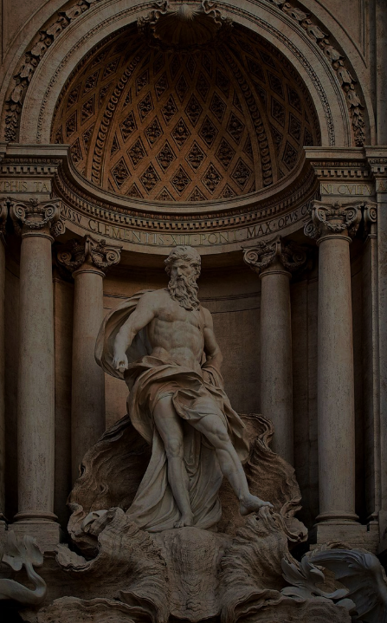
WHAT IS CLASSICAL LITERATURE?
Masterpiece works from Roman, Greek, and other ancient civilizations
Includes epics, tragedies, comedies, and lyrics
Popular authors are Homer, Sophocles, and Ovid

Slide 3

CLASSICAL VS. CLASSIC LITERATURE
WORK | CLASSICAL | CLASSIC
The Odyssey | X | X
The Tempest |  | X
The Iliad | X | X
Classical works are specifically from Greek, Roman or other ancient civilizations
Classics are great works throughout the ages
All classical literature is considered classic, though not all classic works are classical

Slide 4

EXAMPLES OF CLASSICAL WORKS
Classical works are specifically from Greek, Roman or other ancient civilizations
Classics are great works throughout the ages
All classical literature is considered classic, though not all classic works are classical
GREEK
Odyssey
Iliad
ROMAN
Metamorphoses
Georgics
PERSIAN
Tarikh-i Beyhaqi

Slide 5

CLASSICAL LITERATURE THEMES
Greek & Roman

Slide 6

GREEK VS. ROMAN THEMES
GREEK
ROMAN
Comedy
Tragedy
Fable
Conquest
Governance
Virtue

Slide 7
BUT YOU, BRAVE AND ADEPT FROM THIS DAY ON . . . THERE’S HOPE THAT YOU WILL REACH YOUR GOAL . . . THE JOURNEY THAT STIRS YOU NOW IS NOT FAR OFF.
“
”
- HOMER, THE ODYSSEY

Slide 8

IS CLASSICAL LITERATURE STILL RELEVANT TODAY?

Slide 9

ANCIENT TEXT IN
THE 21ST CENTURY
Opinions vary on whether classical literature should be included in contemporary studies
Some believe it is integral to helping students understand complex ideas
Others believe more modern texts should be focused on due to their relevance
WHAT ARE YOUR THOUGHTS?
  Do you think classical literature
  has an important place in today’s education system?

Slide 10

SOURCES
WEBSITES
www.contoso.com
www.relecloud.com
TEXTS
The Odyssey
The Iliad
Tarikh-i Beyhaqi
Georgics
Metamorphoses

